Slide 1
Manual Testing
Steps to Manual Testing
Write code
Uploading the code to some place
Build it
Running the code manually (in many cases filling up forms etc step by step)
Check Log files, Database, External Services, Values of variable names, Output on the screen etc
If it does not work, wash, rinse, repeat

Slide 2
Problems with Manual Testing
Requires Complete System (order form and order list) to be completed
Difficult to isolate where exactly the problem occurred
Environment
UI
Business Logic
Persistence Logic

Slide 3
Problems with Manual Testing
Verify Results with Form and List
Requires both screens to be completed
Not all applications require both, introduces unnecessary work or admin tools
Increases the time between development and testing
With database verification
Can be difficult with complicated database schema
Error Prone
Doesn’t scale well

Slide 4
Problems with Manual Testing
Expensive
Time
Manpower
Boring
No one wants to click around and fill in form fields all day

Slide 5
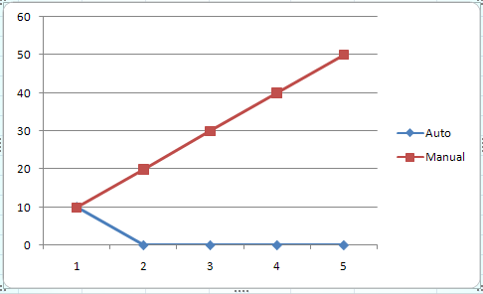
Effort & Costs of Testing
Lets assume 6 test cases
Effort required to run all 6 manually => 10 min
Effort required to write unit tests for all 6 cases => 10 min
Effort required to run unit tests for all 6 cases => < 1 min
Number of testing iterations => 5
Total manual testing time => 50 min
Total unit testing time => 10 min
Release | Manual Test | Auto Test | Manual Test Cumulative
1 | 10 | 10 | 10
2 | 10 | 0 | 20
3 | 10 | 0 | 30
4 | 10 | 0 | 40
5 | 10 | 0 | 50

Slide 6
What Manual Testing Proves:
Right Now
Your Application Works …
Whenever a change occurs or a feature is added, all tests must be ran again to make sure existing functionality is still working.

Slide 7
Automated Testing
Unit Testing
Tests the functionality of a single component
Integration / Regression Testing
Verifies the new code works with existing code

Slide 8
Automated Testing
Isolate Problems to specific areas, even to the method
Reduces chance one team member breaks code from another team member
Over time, creates a battery of tests so that you know the state of your application.

Slide 9
Automated Testing
Improves Application Design
High cohesion, Low Coupling

Slide 10
Automated Testing
Transforms Your QA Department
Focuses on Verify Business Requirements
Edge cases
Manual Tests are still necessary
Just Not as Many

Slide 11
Automated Testing
Insanely cheap when amortized over the life of an application
They only go away when they are no longer testing supported functionality

Slide 12
Unit Tests
Purpose
Verifies functionality at the lowest level
Can be at the class or method level
Design
Should be able to run independent of other tests
Should test the functionality in isolation of other components in the system

Slide 13
Dealing with Interaction
Test Doubles
Ie, fakes, stubs, mocks
Used as “stand ins” for other components in your application
Static vs Dynamic

Slide 14
Qualities of a Good Unit Test
One Logical Test per test method
Independent
Repeatable
Standalone

Slide 15
When To Run Your Tests
All of the Time
Using Continuous Integration tools
Every time code is checked into source control, tests are ran
Can be used to create deployment packages once verified
CruiseControl.Net and JetBrains TeamCity

Slide 16
System Design With Unit Tests
Test Driven Development (TDD)
Design process facilitated by Unit Tests
Helps to design your application in a loosely coupled manner (SOLID design principles)

Slide 17
Steps to TDD
Red
Write the Test First
It should fail for the right reason
Green
Do the simplest thing that will make it work
Reduces Y.A.G.N.I.
Refactor
Clean up implementation without changing behavior
Not Possible without tests in place

Slide 18
Conclusion
Investment in Code Quality
Pay for it up front, receive dividends over the life of the application
Allows for Testing at different levels of the application
Allows for Continuous Improvement of application design
Can become living documentation of the behavior of the system (Behavior Driven Development)
More Fun than Manual Tests

